Slide 1
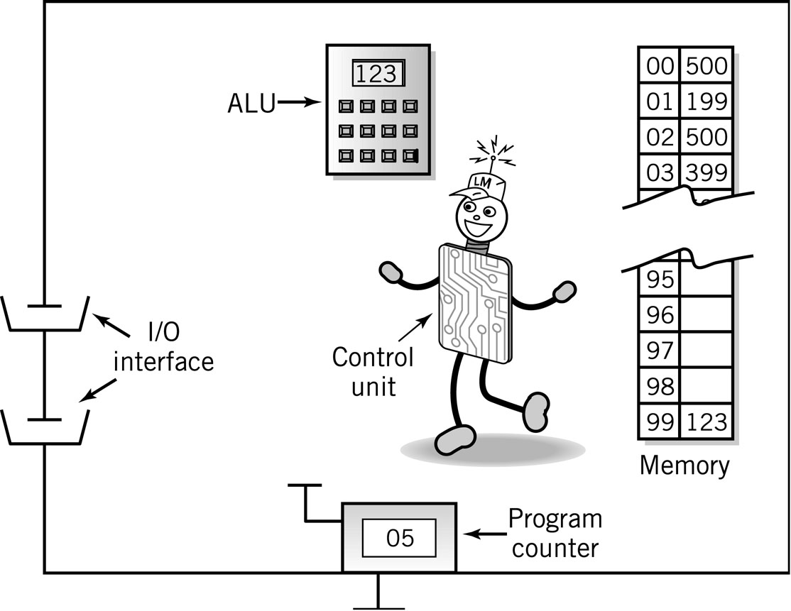
Data Manipulation
Course Code: CSC -101 Credit Hrs:3+1
Course Teacher: Javeria Farooq

Slide 2
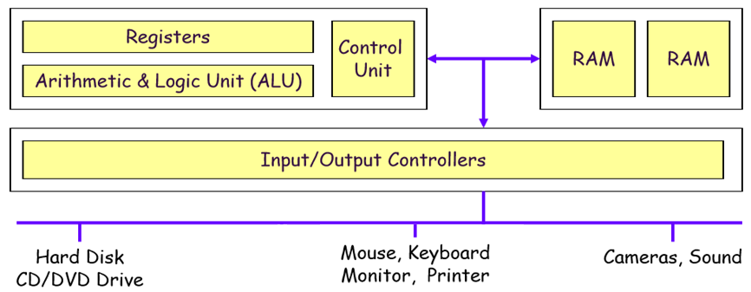
Computer : Key Components

Slide 3
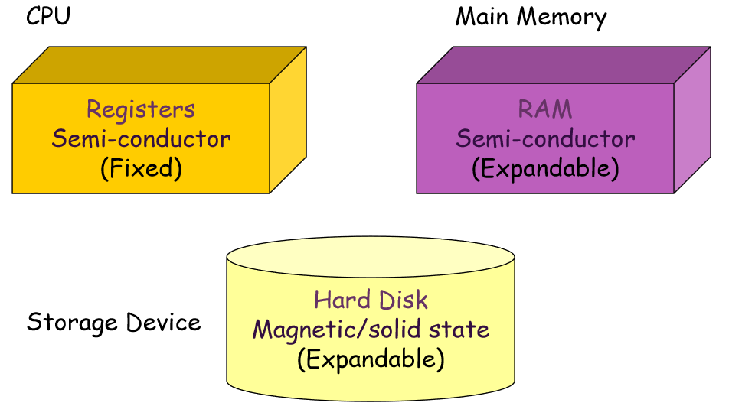
Computer Components: Types of Memory

Slide 4
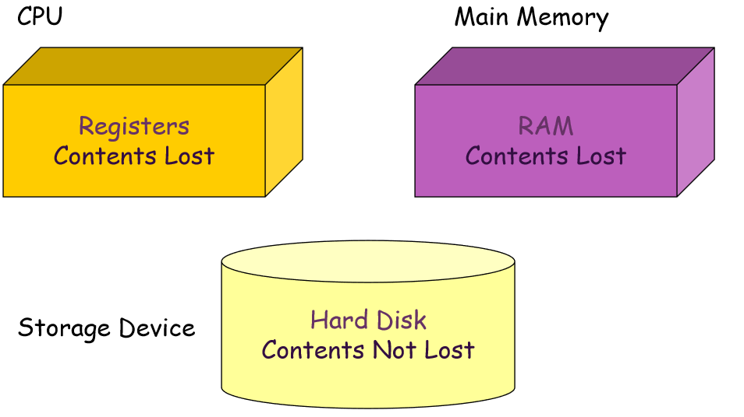
Volatility

Slide 5
Functional units of a computer
Input unit accepts
information:
Human operators
Arithmetic and logic unit(ALU):
Performs the desired
operations on the input
information as determined
by instructions in the memory
Memory
Arithmetic
& Logic
Input
Instr1
Instr2
Instr3
Data1
Data2
Output
Control
I/O
Processor
Output unit sends
results of processing:
To a monitor display,
To a printer
Stores
information:
Instructions,
Data
Control unit coordinates
various actions
Input,
Output
Processing

Slide 6
Memory Unit
Memory unit stores instructions and data.
Recall, data is represented as a series of bits.
To store data, memory unit thus stores bits.
Processor reads instructions and reads/writes data from/to the memory during the execution of a program.
In theory, instructions and data could be fetched one bit at a time.
In practice, a group of bits is fetched at a time.
In order to read/write to and from memory, a processor should know where to look:
“Address” is associated with each data location.

Slide 7
Memory Unit (cont’d)
Primary storage of the computer consists of RAM units.
Primary storage is insufficient to store large amounts of data and programs.
Primary storage can be added, but it is expensive.
Store large amounts of data on secondary storage devices:
Hard Disk/Hard Drives
Optical disks (CD-ROMS).
Access to the data stored in secondary storage in slower, but take advantage of the fact that some information may be accessed infrequently.
Cost of a memory unit depends on its access time, lesser access time implies higher cost.

Slide 8
Arithmetic and logic unit (ALU)
Operations are executed in the Arithmetic and Logic Unit (ALU).
Arithmetic operations such as addition, subtraction.
Logic operations such as &&, ||, ! Etc.
In order to execute an instruction, operands need to be brought into the ALU from the memory.
Operands are stored in general purpose registers available in the ALU.
Results of the operations are stored back in the memory or keep in the processor for immediate use.

Slide 9
Arithmetic Operation
+
Addition
Subtraction
Multiplication
Division
-
/
*

Slide 10
Logical Operators
Evaluates conditions
Makes comparisons
Can compare
Numbers
Letters
Special characters
NOT
AND
OR

Slide 11
Output Unit
Computers represent information in a binary form.
Accept processed results provided by the computer in binary form.
Convert the information in binary form to be understood by an Output device.
Memory
Computer
Real world
Output Unit
Printer
Graphics display
Speakers
……
Processor

Slide 12
Control Unit
Operations of Input unit, Memory, ALU and Output unit are coordinated by Control unit.
Instructions control “what” operations take place (e.g. data transfer, processing).
Control unit generates timing signals which determines “when” a particular operation takes place.

Slide 13
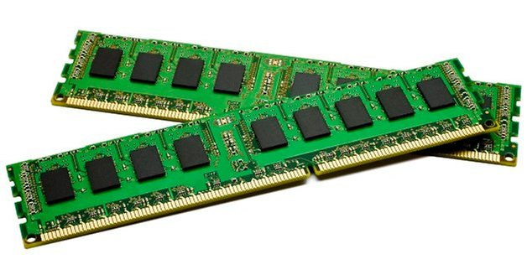
RAM(Random Access Memory)
Operating System
Program currently running
Data needed by the program
Intermediate results waiting to be output

Slide 14
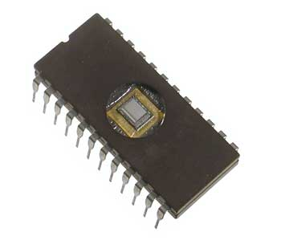
ROM(Read Only Memory)
Non-volatile
Instructions for booting the computer
Data and instructions can be read, but not modified

Slide 15
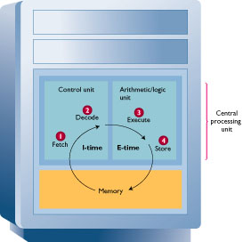
Executing Program
Fetch
CU gets an instruction
Decode
CU decodes the instruction
Execute
CU notifies the appropriate part of hardware to take action
Control is transferred to the appropriate part of hardware
Task is performed
Store
Control is returned to the CU

Slide 16
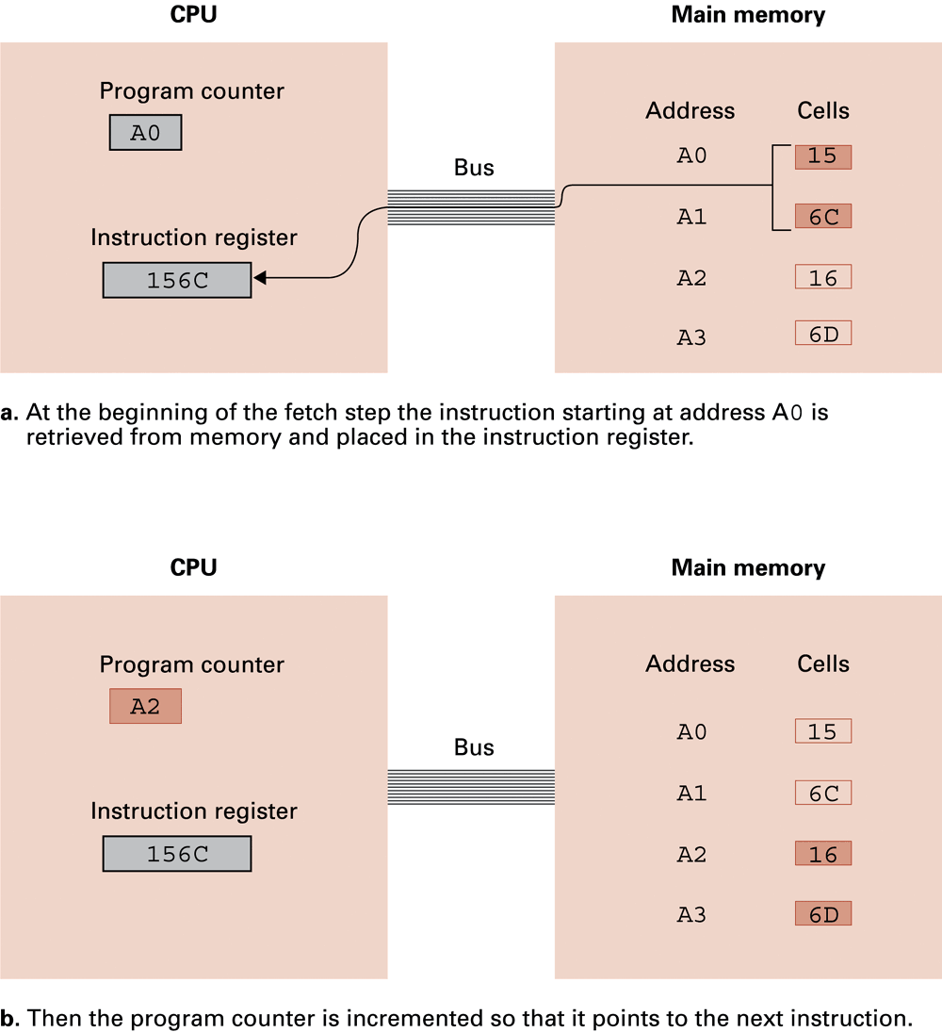
Performing the fetch step of the machine cycle
Representing Memory in Bytes
8 bits = 1 Byte
Representing 16 Bits

Slide 17
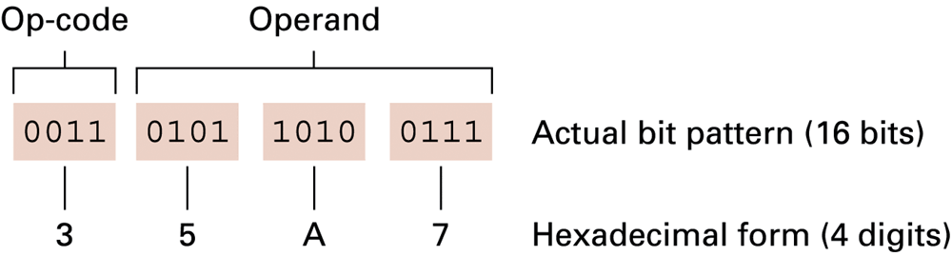
The composition of an instruction for the machine

Slide 18
Performing the fetch step of the machine cycle (cont’d)

Slide 19
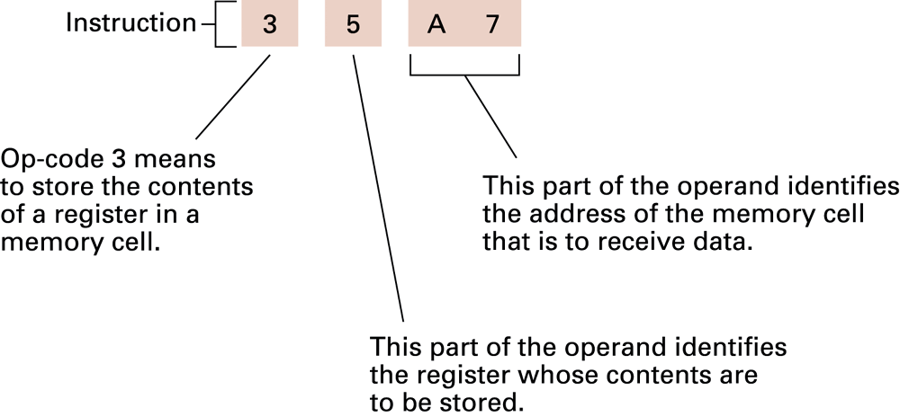
Decoding the instruction 35A7

Slide 20
Number System

Slide 21
Common Number Systems
System | Base | Symbols
Decimal | 10 | 0, 1, … 9
Binary | 2 | 0, 1
Octal | 8 | 0, 1, … 7
Hexadecimal | 16 | 0, 1, … 9, A, B, … F

Slide 22
Conversion Among Bases
The possibilities:
Decimal
Octal
Binary
Hexadecimal

Slide 23
Binary to Decimal and Decimal to Binary
Bit “0”
101011₂ => 1 x 2⁰ = 1 1 x 2¹ = 2 0 x 2² = 0 1 x 2³ = 8 0 x 2⁴ = 0 1 x 2⁵ = 32
=43₁₀
2 125 62 1
125₁₀ = ?₂
2 31 0
2 15 1
2 7 1
2 3 1
2 1 1
Binary to Decimal
Decimal to Binary
125₁₀ = 1111101₂

Slide 24
Octal to Decimal and Decimal to Octal
724₈ => 4 x 8⁰ = 4 2 x 8¹ = 16 7 x 8² = 448 =468₁₀
Octal to Decimal
1234₁₀ = ?₈
8 1234
154 2
8
19 2
8
2 3
Decimal to Octal
8
0 2
1234₁₀ = 2322₈

Slide 25
Hexadecimal to Decimal and Decimal to Hexadecimal
ABC₁₆ => C x 16⁰ = 12 x 1 = 12 B x 16¹ = 11 x 16 = 176 A x 16² = 10 x 256 = 2560
=2748₁₀
Hexadecimal to Decimal
1234₁₀ = ?₁₆
16 1234
77 2
16
4 13 = D
16
0 4
Decimal to Hexadecimal
1234₁₀ = 4D2₁₆

Slide 26
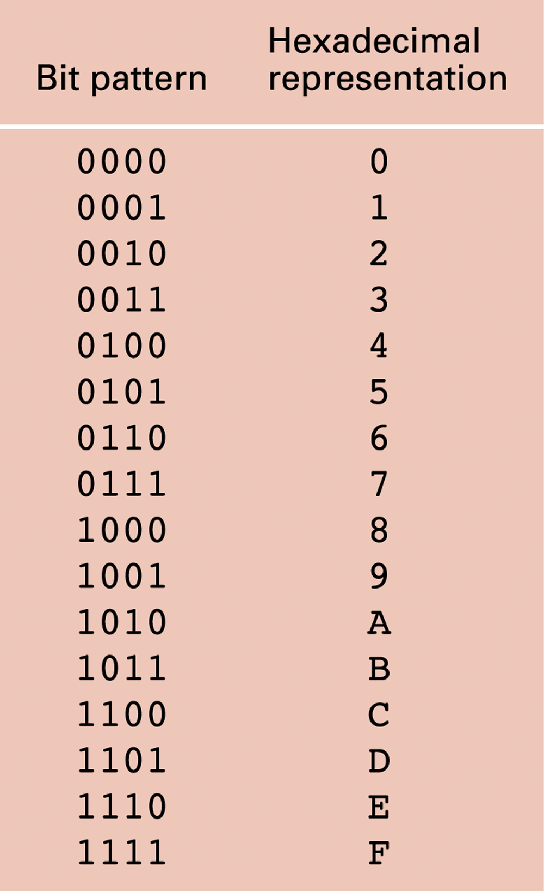
The hexadecimal coding system
Example: 10100011 becomes A3

Slide 27
Octal to Binary and Hexadecimal to Binary
705₈ = ?₂
7 0 5
111 000 101
705₈ = 111000101₂
Octal to Binary
10AF₁₆ = ?₂
1 0 A F
0001 0000 1010 1111
10AF₁₆ = 0001000010101111₂
Hexadecimal to Binary

Slide 28
Binary to Octal and Hexadecimal to Octal
1011010111₂ = ?₈
001 011 010 111
1 3 2 7
1011010111₂ = 1327₈
Binary to Octal
1010111011₂ = ?₁₆
0010 1011 1011
B B
1010111011₂ = 2BB₁₆
Binary to Hexadecimal

Slide 29
Hexadecimal to Octal and Octal to Hexadecimal
1076₈ = ?₁₆
1 0 7 6
001 000 111 110
1076₈ = 23E₁₆
Octal to Hexadecimal
1F0C₁₆ = ?₈
1 F 0 C
0001 1111 0000 1100
1F0C₁₆ = 17414₈
Hexadecimal to Octal
1 7 4 1 4

Slide 30
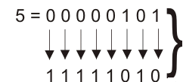
Ones-complement
Negative number
0011 ≡ 3₁₀
1100 ≡ –3₁₀

Slide 31
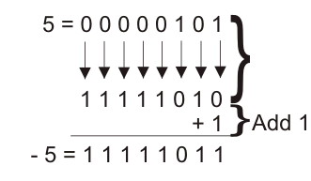
Twos-complement
Arithmetic is easy
Subtraction = negation and addition
Easy to implement in hardware
Used almost universally
Most significant Bit (MSB) represents the Sign Bit so we will consider 2⁷ as negative value.
-128+64+32+16+8+2+1=-5
2⁷
2⁶
2⁵
2⁴
2³
2²
2¹
2⁰
16
8
64
0
-128
32
2
1
Notes:
Note:
0 represents Positive Value.
1 Represents Negative Value.

Slide 32
Representing Text
Each character (letter, punctuation, etc.) is assigned a unique bit pattern.
ASCII (American Standard Code for Information Interchange): Uses patterns of 7-bits to represent most symbols used in written English text.
ISO (International Standard Organization) standard: as developed a number of extensions to ASCII, each of which were designed to accommodate a major language group.
Unicode: Uses patterns of 16-bits to represent the major symbols used in languages world side

Slide 33
The message “Hello.” in ASCII
Encoding text as bit patterns
Decoding bit patterns as text

